Slide 1
CSE 707
Task 2 - Paper Presentation
Paper : Heterogeneous Defect Prediction Based on Federated Reinforcement Learning via Gradient Clustering
Paper Link : https://doi.org/10.1109/ACCESS.2022.3195039
Members:
Fahmida Ahmed – 22241167
Sushana Islam Mim – 22273001
Mirza Ahmad Shayer – 22273008

Slide 2
For the prediction of software defects in projects – a defect prediction model is made by collecting heterogeneous data from other projects. This is called Heterogeneous Defect Prediction (HDP).
Laws and regulations prevent use of original data – which constitutes to the data island. Federated Learning [FL] has various advantages when it comes to heterogeneous data and data island.
In the paper, a novel Federated Reinforcement Learning via Gradient Clustering (FRLGC) was proposed.
Parameters of global model are sent to dueling deep Q network (dueling DQN) then Gaussian differential privacy is used for encryption for security purposes. Lastly, clients are clustered according to their locally encrypted model parameters and weighted average is used for aggregation to make new local and global model.
Experiment was done on nine projects in 3 public databases – Relink, NASA and AEEEM.
FRLGC is shown to be superior than current HDP solutions.

Slide 3
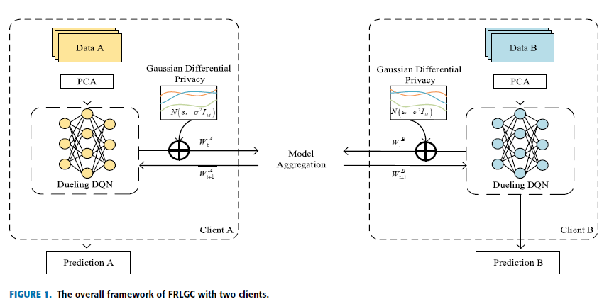
FRLGA overall model – Following steps are given below:
Federated Reinforcement Learning was used for HDP –multiple clients can build global model without exposure.
Original data separated to value and advantage branches, later combined in one layer for better policy making.
Similarity knowledge used. Clients with similar gradients are aggregated locally followed by global aggregation. Ensures better coverage and reduction of differences
Correctness of model proven and performance is evaluated through experiments, which can greatly improve performance.
Each client has 4 stages – data preprocessing, local training, data encryption and model aggregation.

Slide 4
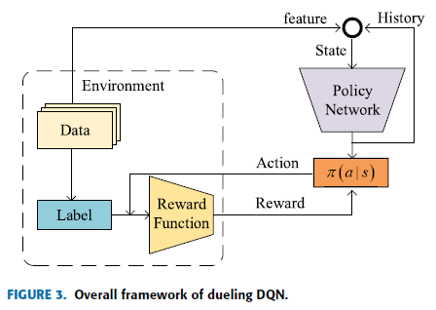
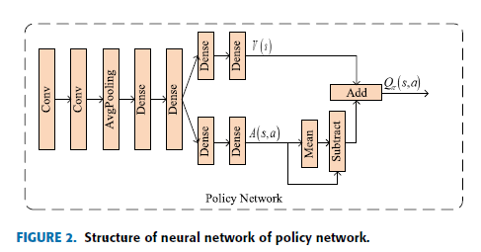

Process details of clients are given below:
PCA is used to reduce dimension of data. Uses the variance of data. PCA has to find an adaptation matrix $A ε R^{d×k}$ . Here $R^{d×k}$ represents real number space, k is a parameter less than x.
A Deep Q Network (DQN) is used. A DQN trains the Q-network by estimating value functions of the actions of a given state. The DQN improves accuracy and efficiency but suffers from overestimation.
In HDP state, actions and rewards are discussed. There are two actions select – 1 and neglect – 0. Two rewards as well r = +1 is action is correct else r = -1 if action is wrong. The goal of each agent is to maximize expectation of cumulative discounted reward as much as possible during the process.
Below the policy network along with overall DQN are shown:

Slide 5

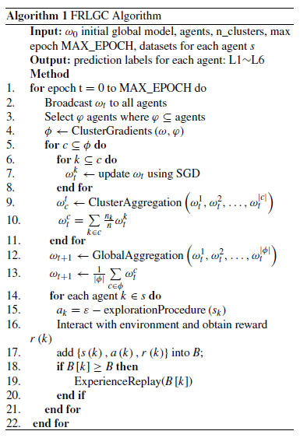
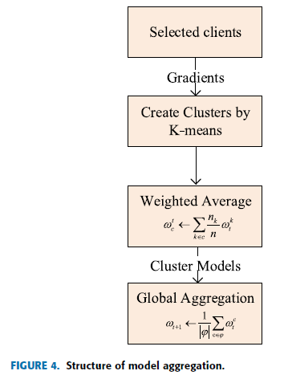
The loss function of the DQN
Gaussian differential privacy has many advantages – no large encryption or decryption processes which saves computing resources and has more data processing efficiency compared traditional cryptography method.
Model aggregation is divided into two steps – local and global aggregation. The structure of aggregation and the FRLGC algorithm are given below.

Slide 6
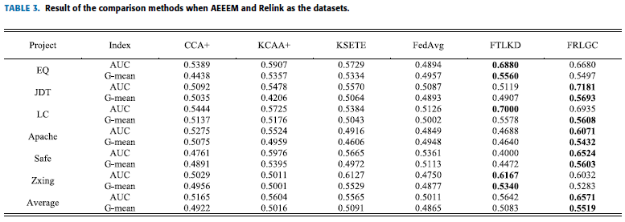
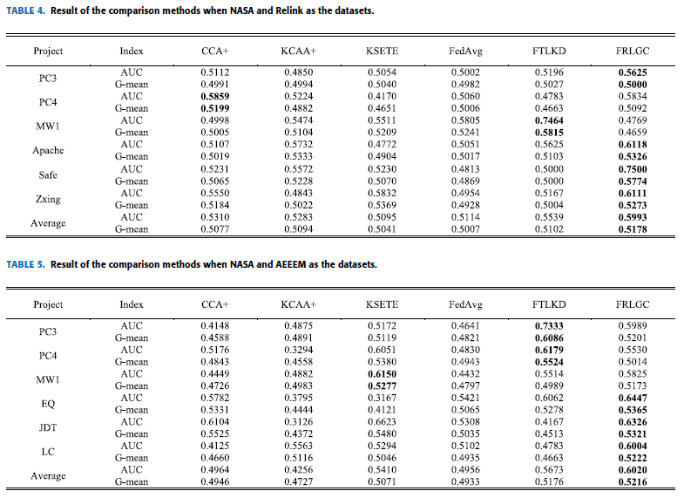
The Results and Comparisons of the FRLGC are given below.
In the future, this study wishes to expand the experiment. More datasets with defects will be used to test the generalization ability. FRLGC needs multiple rounds of communication for each client to realize the convergence of private model. More thought should be given to communication costs. A new algorithm in FRLGC needs to be created to reduce this problem.

Slide 7
Thank You!
Questions?

